Slide 1

Exploratory Data Analysis
US Breweries
October 19, 2019
Antonio Debouse & Quynh Chau

Slide 2
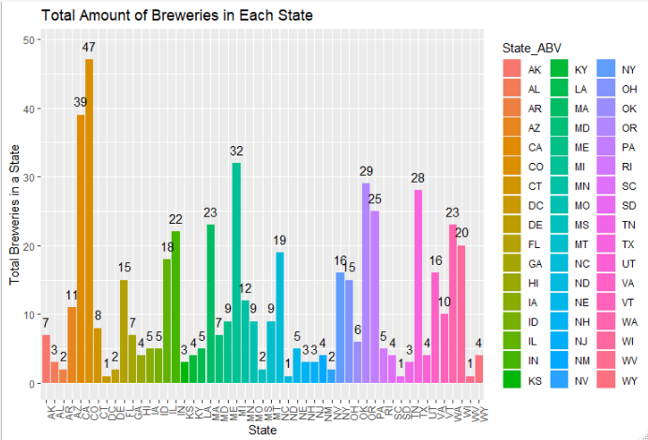
There are currently active 558 breweries in the US in the data base.
Fun Fact: There is a National Beer Day in the US – It is April 7.
Source: http://mentalfloss.com/article/52941/25-amazing-facts-national-beer-day

Slide 3
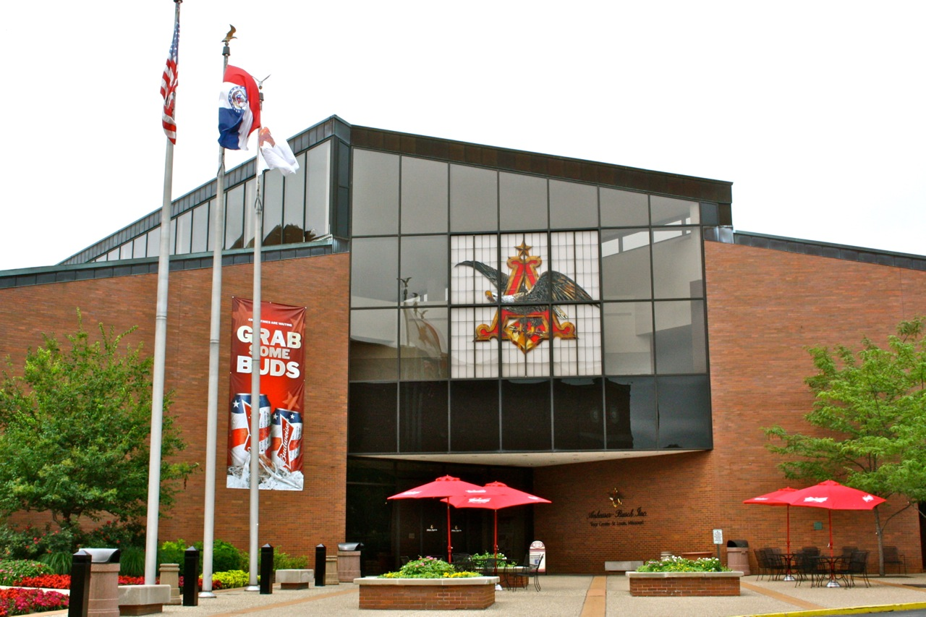
Budweiser Breweries Locations:
States With The Most Breweries:
States with the highest numbers of breweries | Number of Breweries
*CO | 47
*CA | 39
MI | 32
OR | 29
*TX | 28
PA | 25
MA | 23
WA | 23
IN | 22
WI | 20
Budweiser currently has 12 active breweries. Built in 1852, the brewery in St. Louis, MO has been designated a national historical landmark.
Fun Fact: Anheuser Busch – Budweiser’s parent company was one of the first beer producers to use refrigerated railroad cars as a mode of beer distribution.
Source: https://en.wikipedia.org/wiki/Anheuser-Busch
* These states also include Budweiser breweries

Slide 4
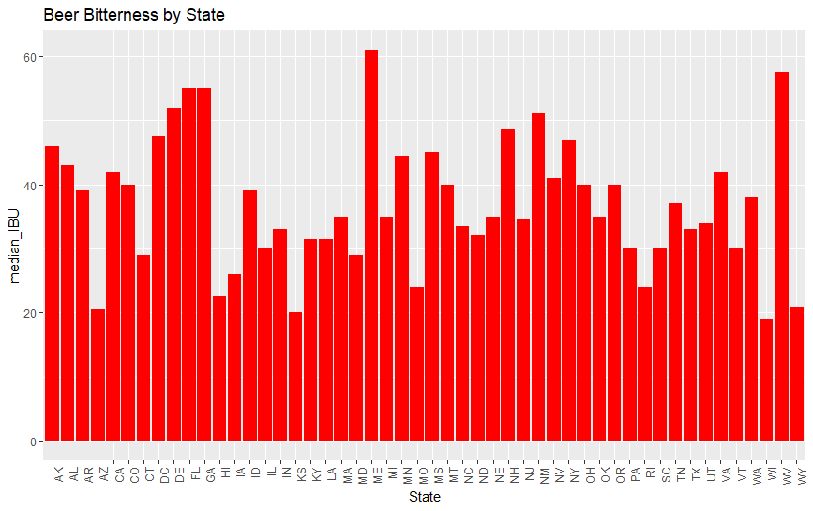
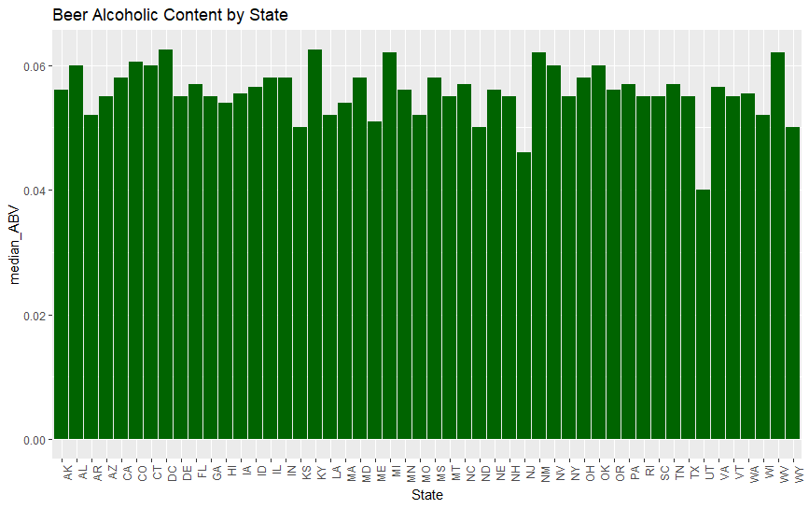

The state of Maine has most bitter beer; the District of Columbia and Kentucky are tied for the most alcoholic content in its beers (as measured median values by state).
Alcoholic content range from 0.1% to 12. 8%
Beer bitterness range from a min of 4 to 138.
Fun Fact: according to Beer Connoisseur, consumer taste trends more toward aroma, flavor and drinkability and less toward malty, beer bitterness and alcohol content. Source: https://beerconnoisseur.com/articles/2019-consumer-trends

Slide 5
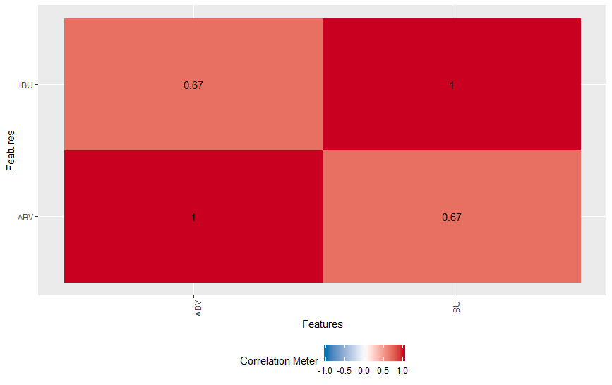
Correlation Between Alcoholic Content (ABV) and Bitterness of Beer (IBU)
(using median values by State)
There is a positive correlation between ABV and IBU of a beer.
Fun Fact:
The alcohol content of a beer is determined by the yeast attenuation and the amount of sugar fermented by yeast during the brewing process. Hops adds bitterness to a beer to balance the sugars. Hops also impart floral, fruity, or citrus flavors and aroma to beer.
Source: https://brewfuse.com/gives-beer-body-flavor-alcohol/
Water
Yeast & Hop
Malt
Beer

Slide 6
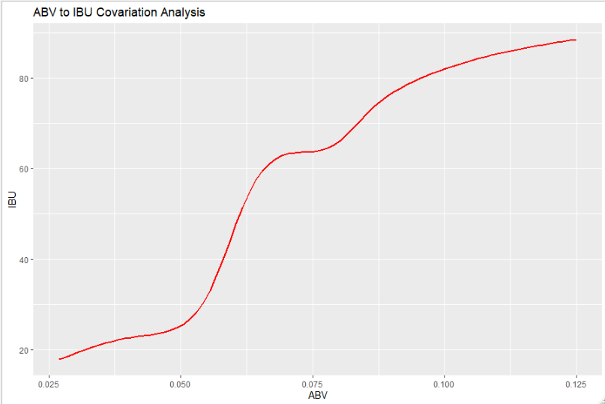
Relationship Between Alcoholic Content (ABV) and Bitterness of Beer (IBU)
Given a beer, There is a slight positive correlation (0.67) between alcoholic content and bitterness.

Slide 7
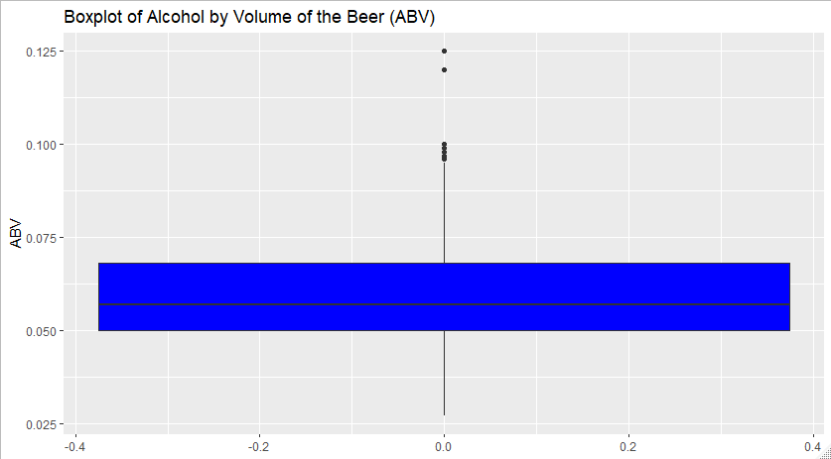
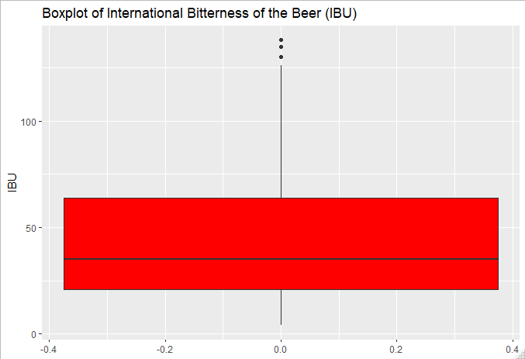

Colorado produces the maximum alcoholic beer – Lee Hill Series Vol. 5 – Belgian Style Quadruple Ale, manufactured by Upslope Brewing Company in Boulder, CO
Oregon produces the most bitter beer with an IBU of 138 – Bitter Bitch Imperial IPA, manufactured by Astoria Brewing Company in Astoria, Oregon.

Slide 8
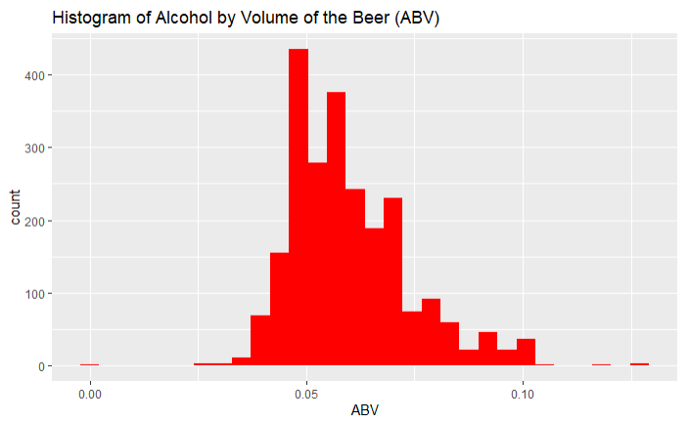

Per the histogram, there appears to be right skewness, which can be attributable to several large ABV data points.
Summary Statistics:
The range of ABV is from a minimum of . 1% to 12.8%; the mean of 5.9% is larger than the median of 5.6%, which can also be seen with the right skewness of the histogram.

Slide 9
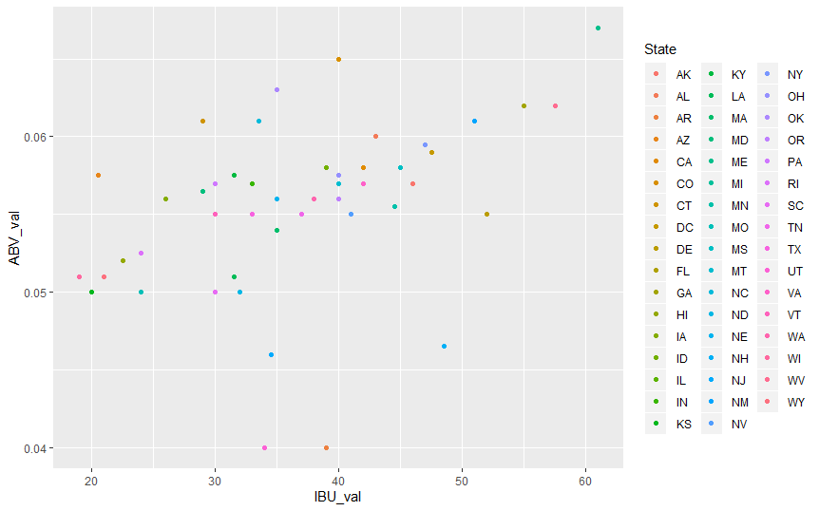
Alcohol Content (ABV_val) and Beer Bitterness (IBU_val) by State (median values)
In general, the more bitter the beer, the higher its alcoholic content. The median ABV content has a small range of 0.05 to 0.06 across the states; In contrast, the IBU has a wider range of 20 to 60 across the states.

Slide 10
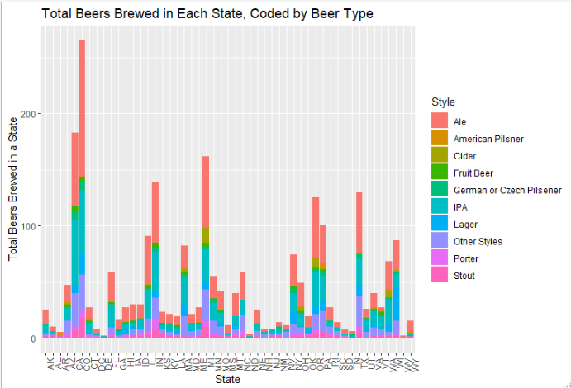
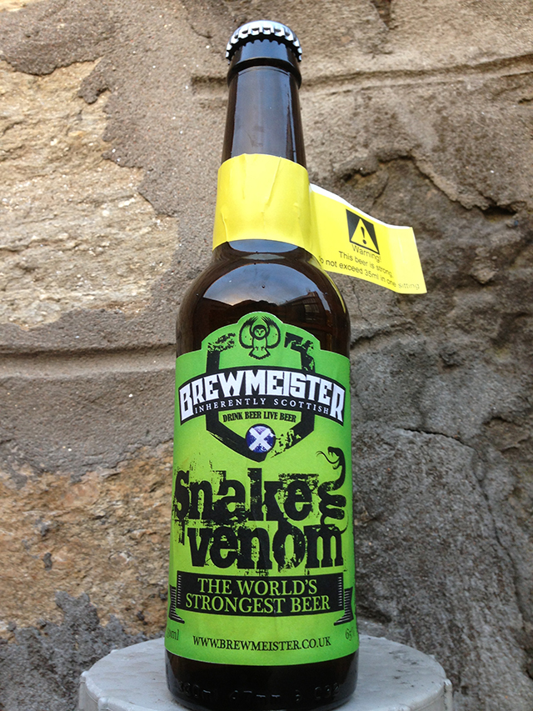
Fun Fact:
Snake Venom, with 67.5% ABV, is one of the world’s strongest beer. It is a British Barley wine style of beer.
Source: https://www.beeradvocate.com/beer/profile/30178/104620/

Slide 11
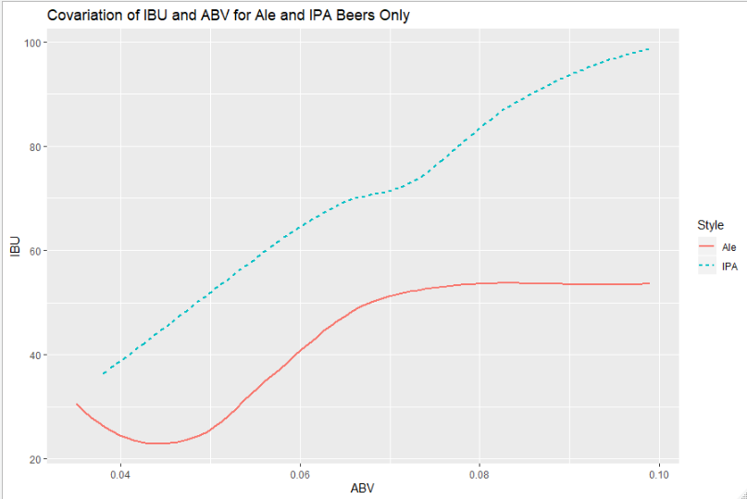
Ales: Alcoholic Content (ABV) and Bitterness (IBU) for India Pale Ales (IPA) and non-IPAs
As a group, IPAs tend to have higher bitterness and higher ABV content than non-IPAs. However, there are some types of pale ales (which include IPAs) with relatively low ABV and IBU.
Fun Fact: India Pale Ales were aptly named due to the fact that this type of ale, developed around the late 1800s and at the height of British colonialism, was the favorite beer of British soldiers in India. IPAs’ extra hops and high alcoholic content acted as strong preservatives for the long voyage to India.
Source: http://allaboutbeer.com/beer_style/india-pale-ale/

Slide 12
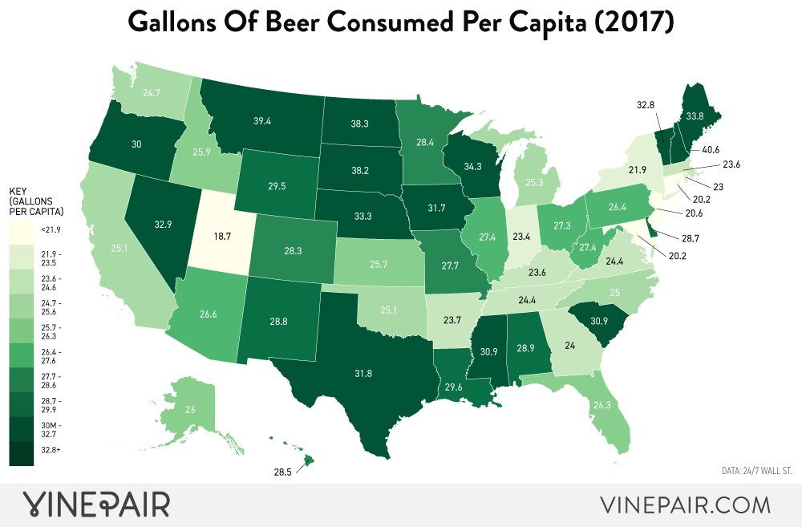

Slide 13
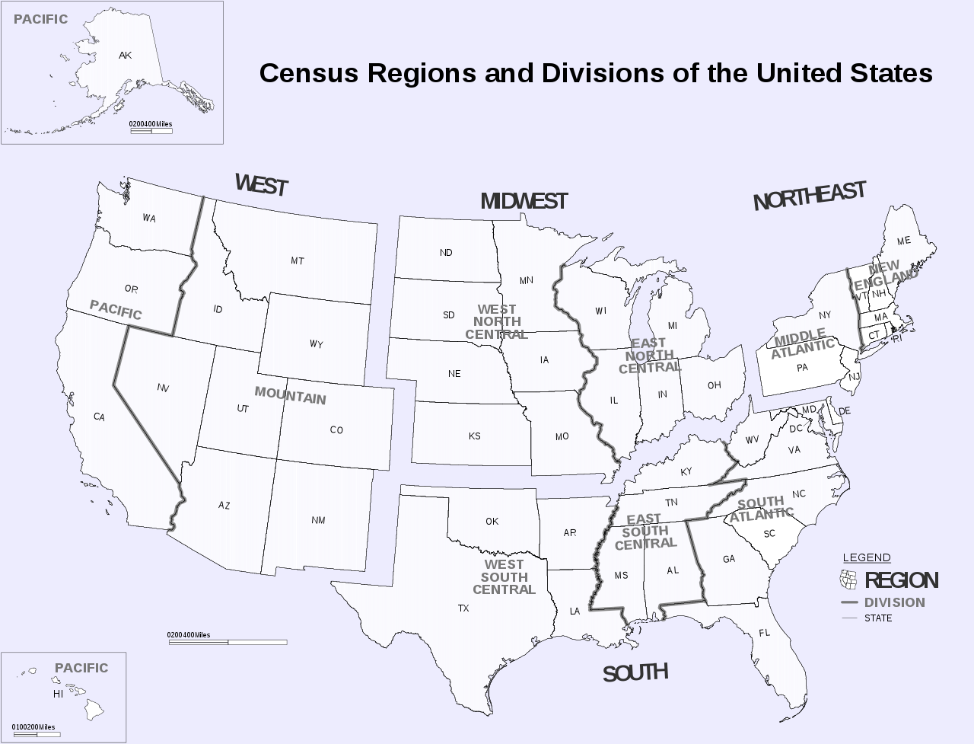
Source: National Geographic

Slide 14
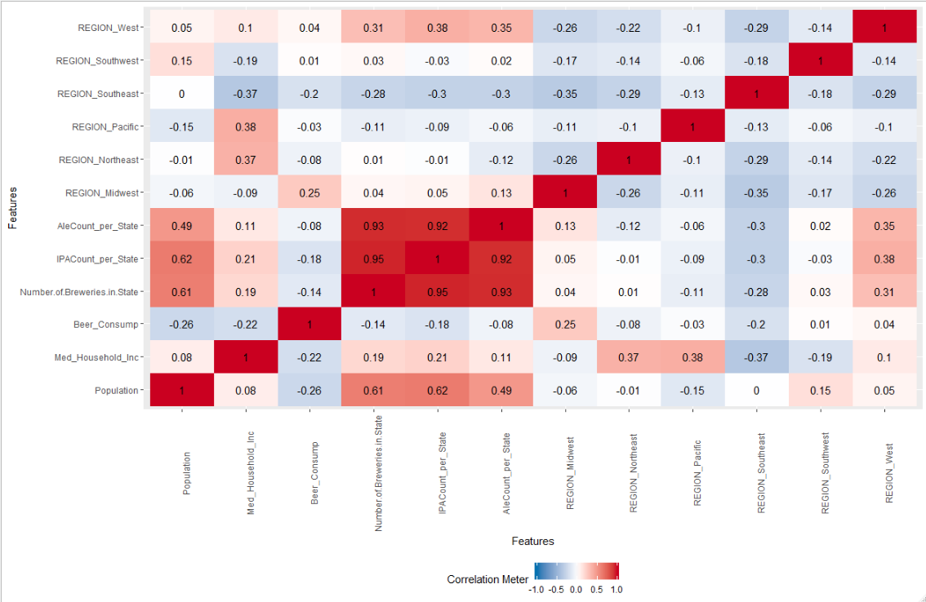
There is a 25% correlation between beer consumption and the Midwest Region of the US.
There also seem to be an undersupply of breweries in the Midwest.
These two factors considered in combination present a good opportunity for Budweiser to expand regionally.

Slide 15
Midwest vs. West region?
Expansion Options:
Buy an underperforming brewery in the targeted region
Build a new brewery in the targeted region
Expand current production
Assumptions: real estate prices are cheaper in the Midwest, and historical population trends can be projected into the future…but this will require further analysis for statistical proof

Slide 16
REFERENCE/DATA ASSUMPTIONS
THE FOLLOWING SECTION DOCUMENTS DATA SOURCES AND DATA CLEANING FOR THE DATA FRAMES USED IN THIS ANALYSIS
Github link: https://github.com/adebouse/Budweiser-Case-Study.git
Knitted html link: file:///C:/Users/Antonio%20Debouse/Desktop/Doing%20Data%20Science/GitHub/Budweiser-Case-Study/Budweiser%20Case%20Study/Budwesier-Case-Study.html

Slide 17
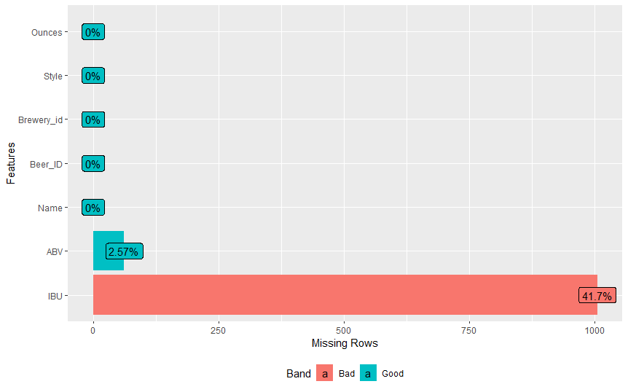
Missing Values Inventory – Beers Data Frame
Data frame: beersdata Rows: 2,410 Columns: 7
Missing data: excluded from the analysis
Alcoholic content for Beer (ABV):
Min. 1st Qu. Median Mean 3rd Qu. Max. NA's
0.00100 0.05000 0.05600 0.05977 0.06700 0.12800 62
Beer Bitterness (IBU
Min. 1st Qu. Median Mean 3rd Qu. Max. NA's
4.00 21.00 35.00 42.71 64.00 138.00 1005

Slide 18
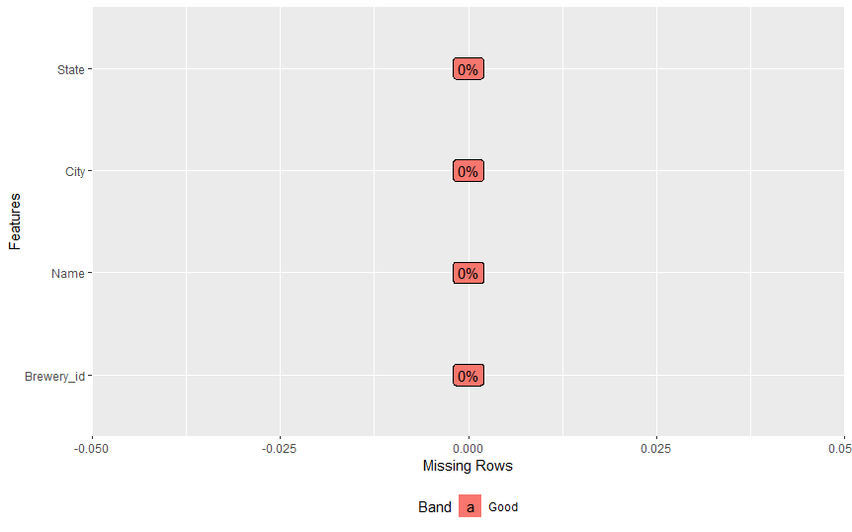
Missing Values Inventory – Breweries Data Frame
Data frame: beersdata
Rows: 558
Columns: 4
Missing data: none

Slide 19
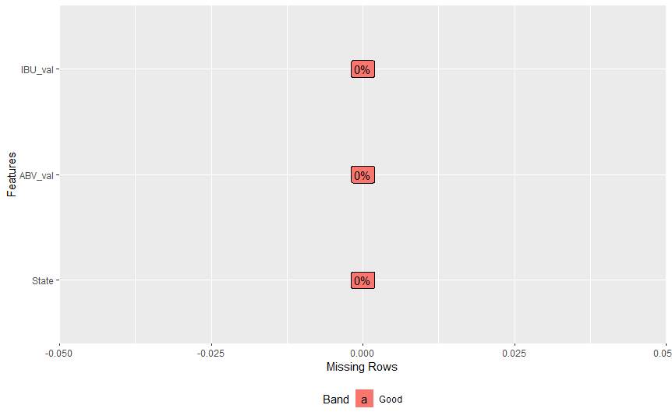
Data Frame: Beer Content
Data Cleaning
Database: Beer Content
Description: this data frame contains median maximum alcoholic (abv) and median bitterness of beer by state.
There are zero missing values because they were excluded from analysis when the original source data frames were merged.

Slide 20
Access for data and coding to replicate analysis
Github link: https://github.com/adebouse/Budweiser-Case-Study.git
Knitted html link: file:///C:/Users/Antonio%20Debouse/Desktop/Doing%20Data%20Science/GitHub/Budweiser-Case-Study/Budweiser%20Case%20Study/Budwesier-Case-Study.html
Youtube: https://youtu.be/AeWrYOZIPMc

